Slide 1
MET CS 555 – Foundations of Machine Learning Lecture 12: Logistic Regression
Hongsheng Wu
Boston University

Slide 2
Study Guide
Logistic Regression
Interpretation of Logistic Regression Results
Formal Inference in Logistic Regression
Model Fitness in Logistic Regression
Receiver Operating Characteristic Curve (ROC Curve)

Slide 3
Logistic Regression

Slide 4
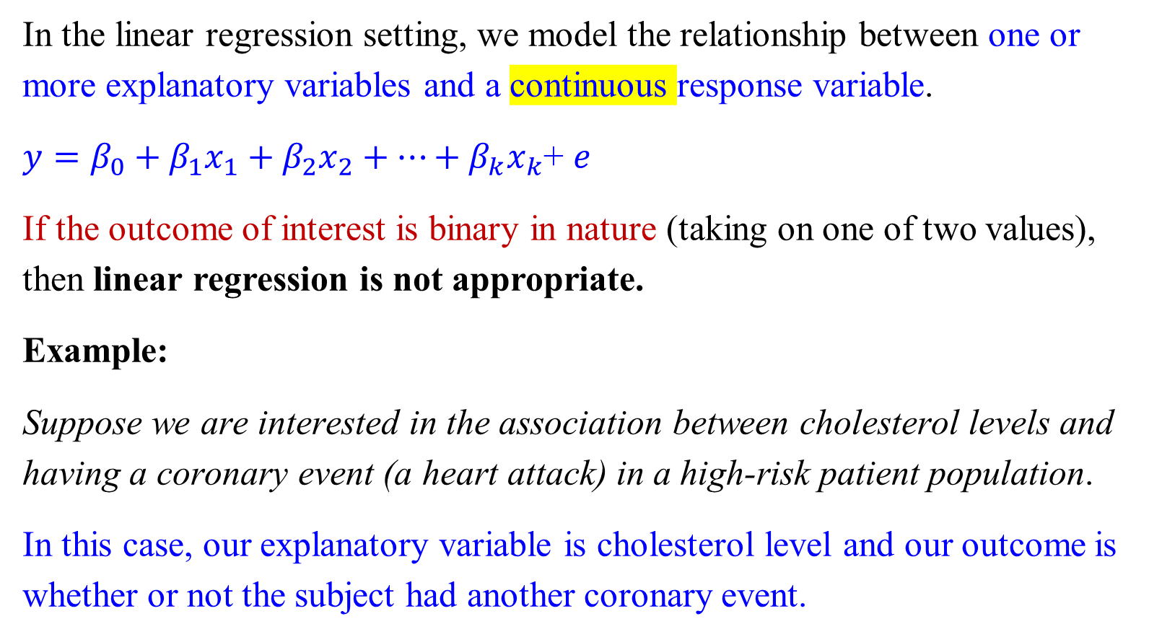
Logistic Regression
In the linear regression setting, we model the relationship between one or more explanatory variables and a continuous response variable.
$y=β_{0}+β_{1}x_{1}+β_{2}x_{2}+…+β_{k}x_{k}$+ $e$
If the outcome of interest is binary in nature (taking on one of two values), then linear regression is not appropriate.
Example:
Suppose we are interested in the association between cholesterol levels and having a coronary event (a heart attack) in a high-risk patient population.
In this case, our explanatory variable is cholesterol level and our outcome is whether or not the subject had another coronary event.

Slide 5
Logistic Regression
Many of the assumptions required for Linear Regression are not met in this setting (for example, linearity, constant variance and normality of the residuals), so the inference is not valid.

Slide 6
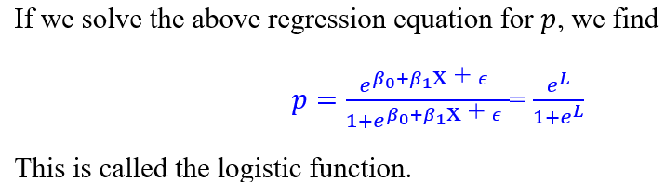
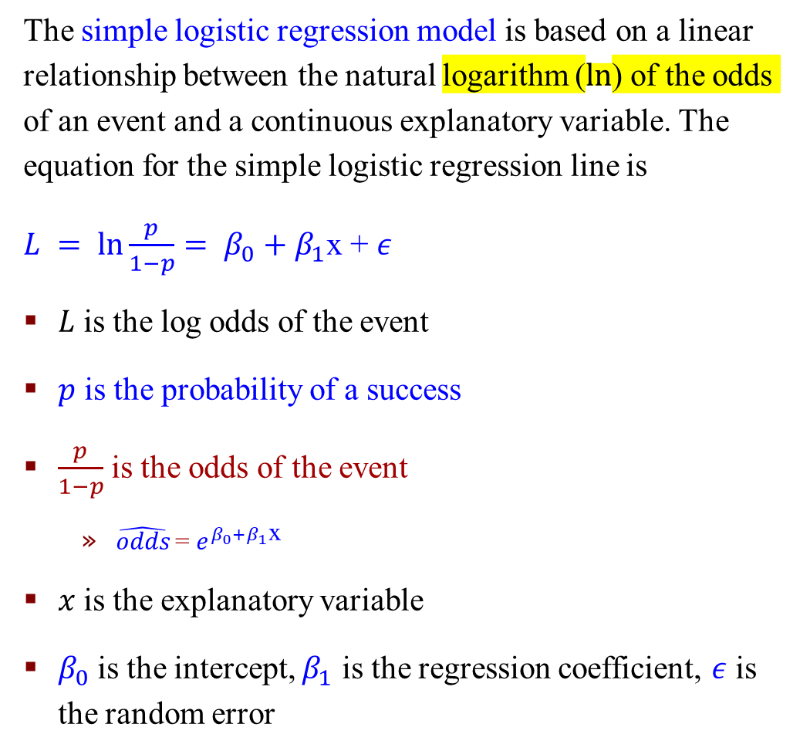
Simple Logistic Regression
The simple logistic regression model is based on a linear relationship between the natural logarithm ($ln$) of the odds of an event and a continuous explanatory variable. The equation for the simple logistic regression line is
$L = ln\frac{p}{1−p}= β_{0}+β_{1}$x + $ε$
$L$ is the log odds of the event
$p$ is the probability of a success
$\frac{p}{1−p}$ is the odds of the event
$\hat{odds}$= $e^{β_{0}+β_{1}\text{x} }$
$x$ is the explanatory variable
$β_{0}$is the intercept, $β_{1}$ is the regression coefficient, $ε$ is the random error
Notes:
$ε$ Epsilon

Slide 7
Interpretation of Logistic Regression Results

Slide 8
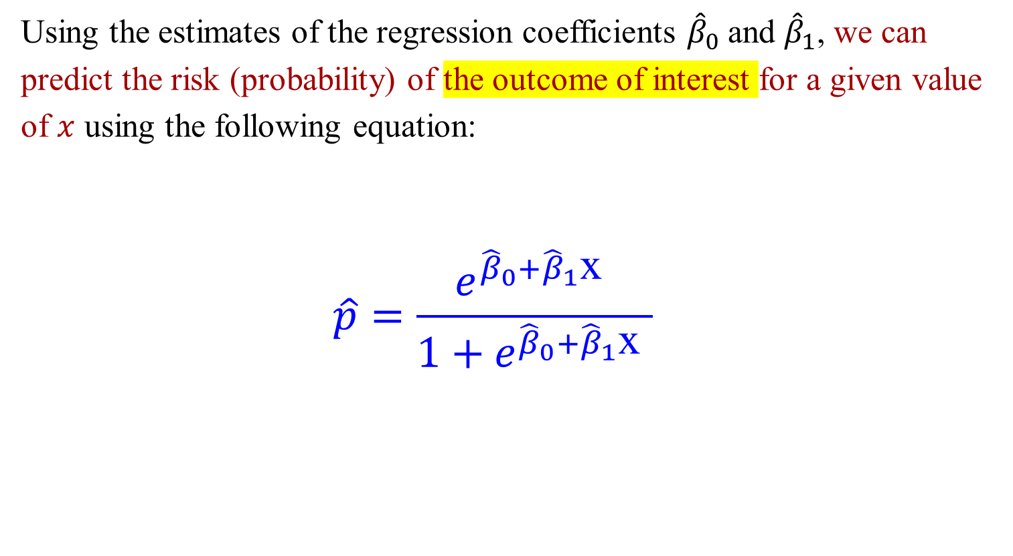
Interpretation
Using the estimates of the regression coefficients ${\hat{β}}_{0}$and ${\hat{β}}_{1}$, we can predict the risk (probability) of the outcome of interest for a given value of $x$ using the following equation:
$$\hat{p}=\frac{e^{{\hat{β}}_{0}+{\hat{β}}_{1}\text{x} }}{1+e^{{\hat{β}}_{0}+{\hat{β}}_{1}\text{x} }}$$

Slide 9
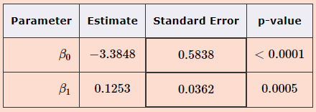
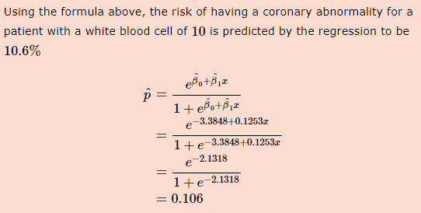
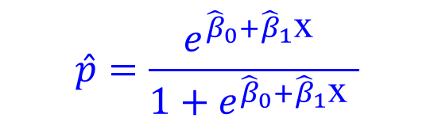
Exercise
The relationship between white blood cell counts and development of a coronary abnormality was explored using a logistic regression model. The output of the model is summarized in the table below. Find the risk of a coronary abnormality for a patient with a white blood cell count of 10
$$\hat{p}=\frac{e^{{\hat{β}}_{0}+{\hat{β}}_{1}\text{x} }}{1+e^{{\hat{β}}_{0}+{\hat{β}}_{1}\text{x} }}$$

Slide 10
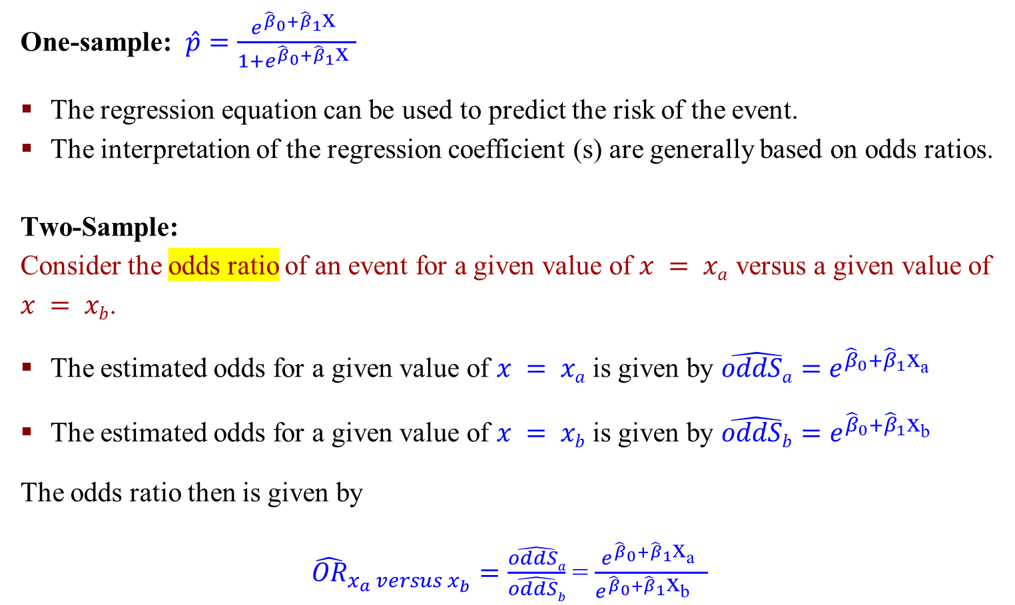
Interpretation
One-sample: $\hat{p}=\frac{e^{{\hat{β}}_{0}+{\hat{β}}_{1}\text{x} }}{1+e^{{\hat{β}}_{0}+{\hat{β}}_{1}\text{x} }}$
The regression equation can be used to predict the risk of the event.
The interpretation of the regression coefficient (s) are generally based on odds ratios.
Two-Sample:
Consider the odds ratio of an event for a given value of $x = xa$ versus a given value of $x = xb$.
The estimated odds for a given value of $x = xa$is given by $\hat{oddSa}=$ $e^{{\hat{β}}_{0}+{\hat{β}}_{1}\text{x}\text{a} }$
The estimated odds for a given value of $x = xb$ is given by $\hat{oddSb}=$ $e^{{\hat{β}}_{0}+{\hat{β}}_{1}\text{x}\text{b} }$
The odds ratio then is given by
${\hat{OR}}_{x_{a} versus x_{b}}=\frac{\hat{oddSa}}{\hat{oddSb}}$ = $\frac{e^{{\hat{β}}_{0}+{\hat{β}}_{1}\text{x}\text{a} }}{e^{{\hat{β}}_{0}+{\hat{β}}_{1}\text{x}\text{b} } }$

Slide 11
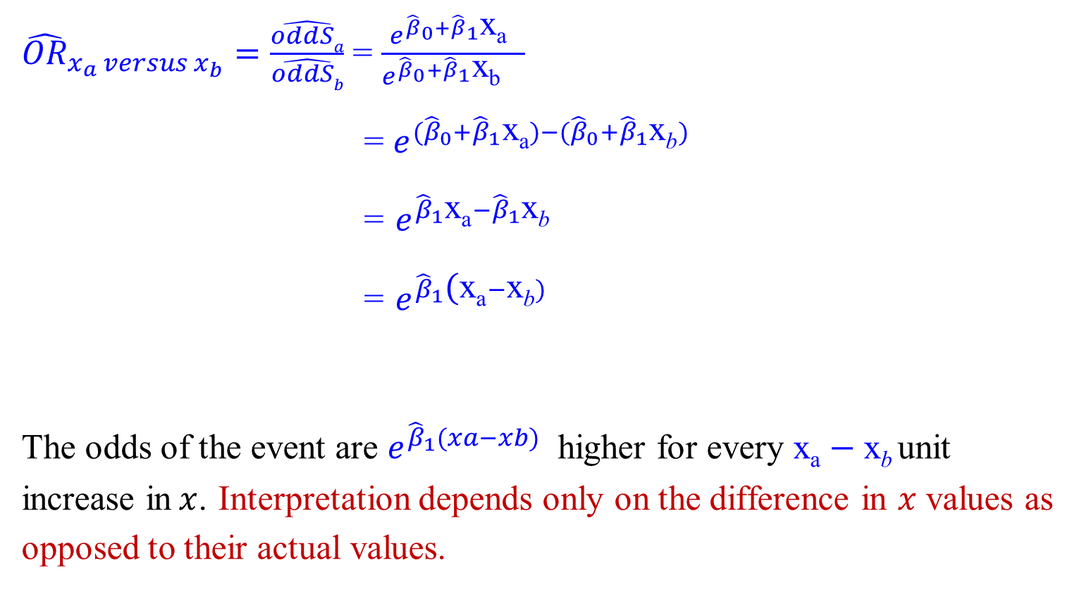
Interpretation
${\hat{OR}}_{x_{a} versus x_{b}}=\frac{\hat{oddSa}}{\hat{oddSb}}$ = $\frac{e^{{\hat{β}}_{0}+{\hat{β}}_{1}\text{x}\text{a} }}{e^{{\hat{β}}_{0}+{\hat{β}}_{1}\text{x}\text{b} } }$
= $e^{{(\hat{β}}_{0}+{\hat{β}}_{1}\text{x}\text{a})−{(\hat{β}}_{0}+{\hat{β}}_{1}\text{x}\text{b})}$
= $e^{{\hat{β}}_{1}\text{x}\text{a}−{\hat{β}}_{1}\text{x}\text{b}}$
= $e^{{\hat{β}}_{1}\text{(}\text{x}\text{a}−\text{x}\text{b})}$
The odds of the event are $e^{{\hat{β}}_{1}(xa−xb) }$higher for every $\text{x}\text{a}−\text{x}\text{b}$unit increase in$x$. Interpretation depends only on the difference in $x$ values as opposed to their actual values.

Slide 12
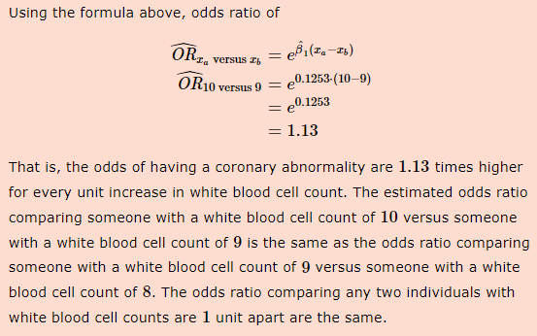
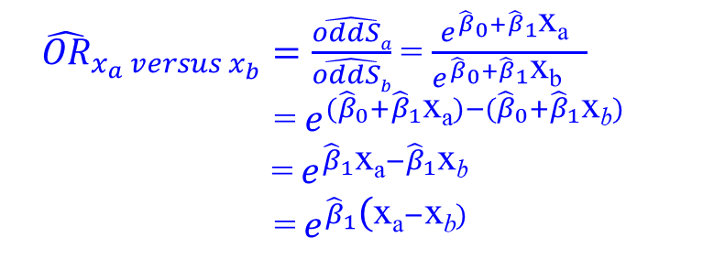
Exercise
The relationship between white blood cell counts and development of a coronary abnormality was explored using a logistic regression model. The output of the model is summarized in the table below. Use these to calculate the odds ratio for a coronary abnormality for someone with a white blood cell count of 10 versus a white blood cell count of 9
${\hat{OR}}_{x_{a} versus x_{b}}=\frac{\hat{oddSa}}{\hat{oddSb}}$ = $\frac{e^{{\hat{β}}_{0}+{\hat{β}}_{1}\text{x}\text{a} }}{e^{{\hat{β}}_{0}+{\hat{β}}_{1}\text{x}\text{b} } }$
= $e^{{(\hat{β}}_{0}+{\hat{β}}_{1}\text{x}\text{a})−{(\hat{β}}_{0}+{\hat{β}}_{1}\text{x}\text{b})}$
= $e^{{\hat{β}}_{1}\text{x}\text{a}−{\hat{β}}_{1}\text{x}\text{b}}$
= $e^{{\hat{β}}_{1}\text{(}\text{x}\text{a}−\text{x}\text{b})}$

Slide 13
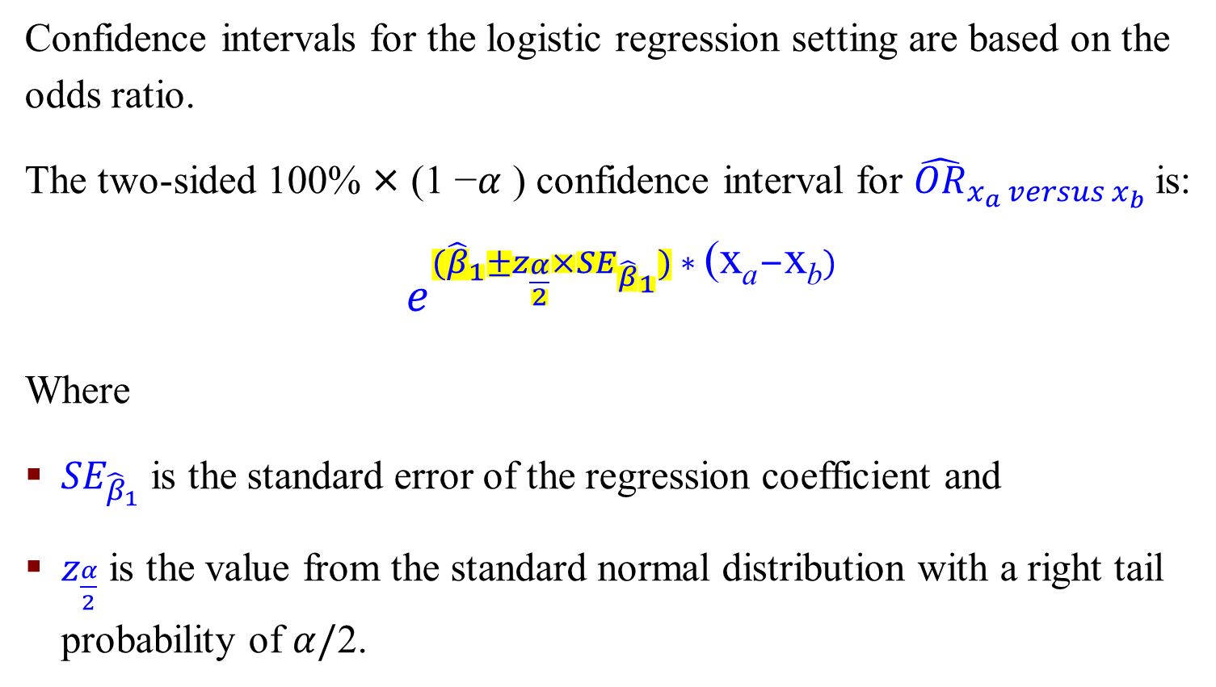
Confidence Interval
Confidence intervals for the logistic regression setting are based on the odds ratio.
The two-sided 100% × (1 −$α$ ) confidence interval for ${\hat{OR}}_{x_{a} versus x_{b}}$is:
$e^{{(\hat{β}}_{1}±z_{\frac{α}{2}}×{SE}_{{\hat{β}}_{1}}) ∗ \text{(}\text{x}\text{a}−\text{x}\text{b})}$
Where
${SE}_{{\hat{β}}_{1}}$is the standard error of the regression coefficient and
$z_{\frac{α}{2}}$is the value from the standard normal distribution with a right tail probability of $α/$2.

Slide 14
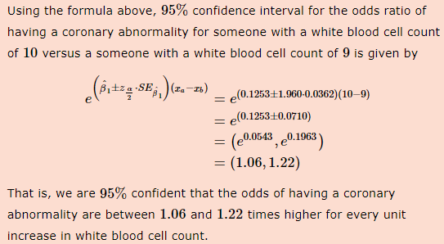
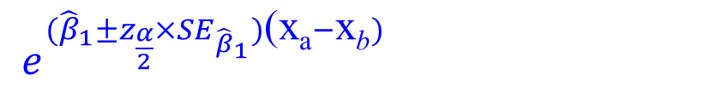
Exercise
The relationship between white blood cell counts and development of a coronary abnormality was explored using a logistic regression model. The output of the model is summarized in the table below. Calculate the 95% confidence interval for the odds ratio for a coronary abnormality for someone with a white blood cell count of 10 versus a white blood cell count of 9.
$e^{{(\hat{β}}_{1}±z_{\frac{α}{2}}×{SE}_{{\hat{β}}_{1}})\text{(}\text{x}\text{a}−\text{x}\text{b})}$

Slide 15
An Example: Logistic Regression
We are interested in the association between cholesterol levels and coronary events in a high-risk patient population (who have had an event in the past). We collect cholesterol data for 50 subjects and then follow each for a year to see if they have another coronary event.
The explanatory variable is cholesterol level, and our outcome is whether or not the subject had another coronary event.
Given the nature of our response variable, we perform a logistic regression. A summary of the beta estimates from the model is shown below.

Slide 16
An Example: Logistic Regression
Use these results to
predict the risk of another coronary event for a high-risk patient with a cholesterol level of 190
calculate the odds ratio for a coronary event of a high-risk patient with a cholesterol level of 190 versus a patient with a cholesterol level of 180
calculate 95% confidence interval for the odds ratio of having a coronary event for a patient with a cholesterol level of 190 versus a patient with a cholesterol level of 180.

Slide 17
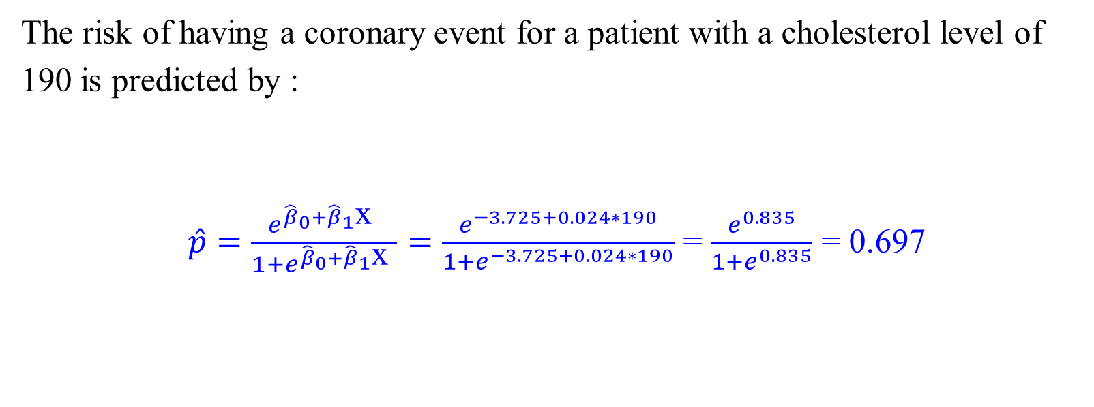
An Example: Logistic Regression
The risk of having a coronary event for a patient with a cholesterol level of 190 is predicted by :
$\hat{p}=\frac{e^{{\hat{β}}_{0}+{\hat{β}}_{1}\text{x} }}{1+e^{{\hat{β}}_{0}+{\hat{β}}_{1}\text{x} }}=\frac{e^{−3.725+0.024∗190}}{1+e^{−3.725+0.024∗190}}$ = $\frac{e^{0.835}}{1+e^{0.835}}$ = 0.697

Slide 18
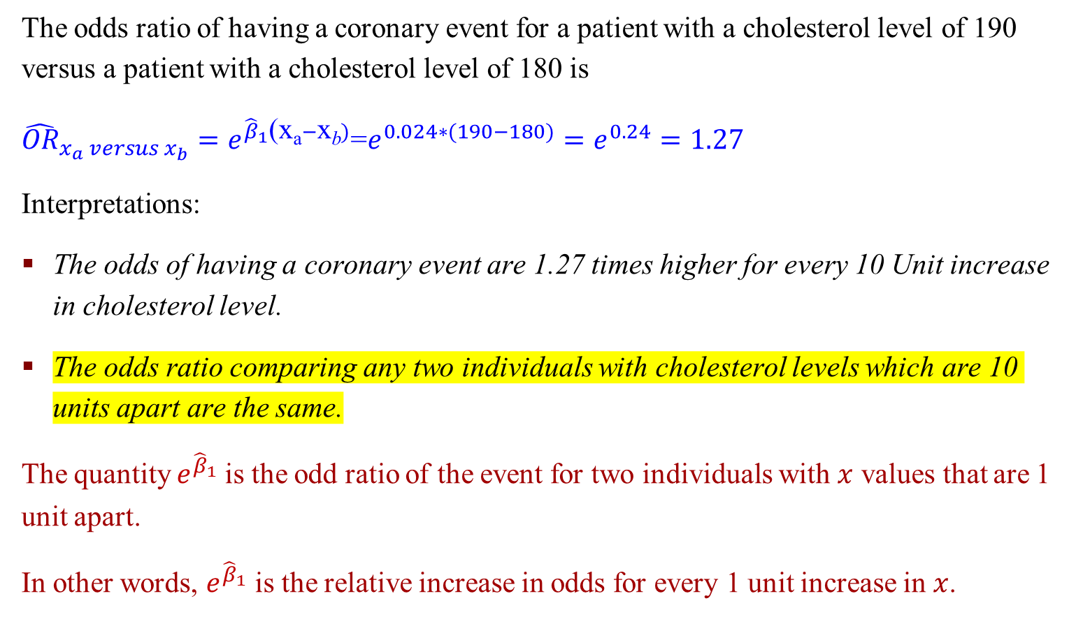
An Example: Logistic Regression
The odds ratio of having a coronary event for a patient with a cholesterol level of 190 versus a patient with a cholesterol level of 180 is
${\hat{OR}}_{x_{a} versus x_{b}}=e^{{\hat{β}}_{1}\text{(}\text{x}\text{a}−\text{x}\text{b})}$=$e^{0.024∗(190−180)}=e^{0.24}=1.27$
Interpretations:
The odds of having a coronary event are 1.27 times higher for every 10 Unit increase in cholesterol level.
The odds ratio comparing any two individuals with cholesterol levels which are 10 units apart are the same.
The quantity $e^{{\hat{β}}_{1}}$is the odd ratio of the event for two individuals with $x$ values that are 1 unit apart.
In other words, $e^{{\hat{β}}_{1}}$ is the relative increase in odds for every 1 unit increase in $x$.

Slide 19
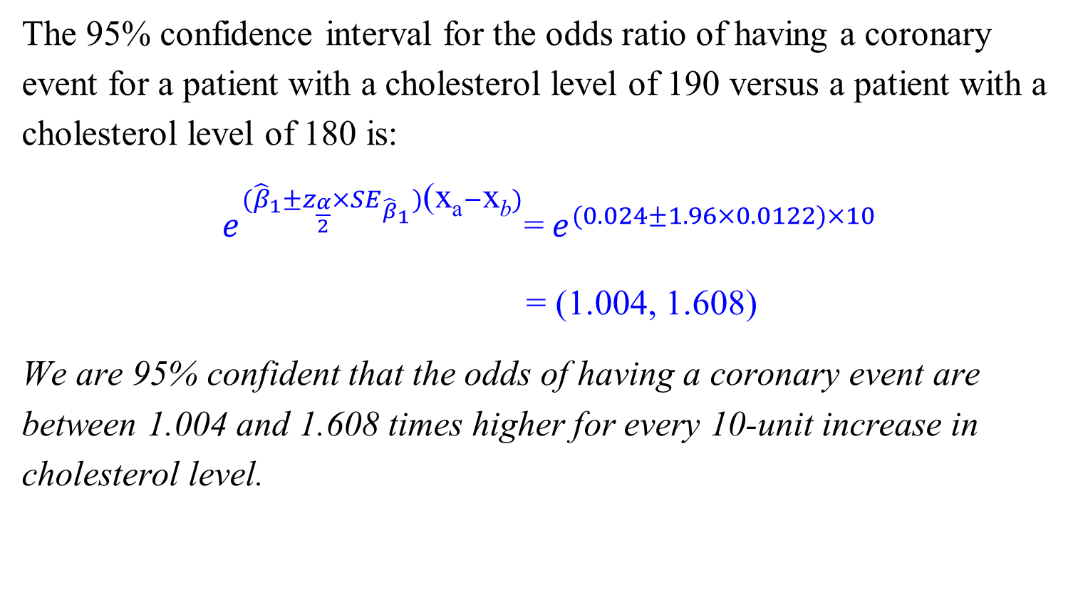
An Example: Logistic Regression
The 95% confidence interval for the odds ratio of having a coronary event for a patient with a cholesterol level of 190 versus a patient with a cholesterol level of 180 is:
$e^{{(\hat{β}}_{1}±z_{\frac{α}{2}}×{SE}_{{\hat{β}}_{1}})\text{(}\text{x}\text{a}−\text{x}\text{b})}$=${ e}^{(0.024±1.96×0.0122)×10}$
= (1.004, 1.608)
We are 95% confident that the odds of having a coronary event are between 1.004 and 1.608 times higher for every 10-unit increase in cholesterol level.

Slide 20
Generalized Linear Models (GLMs)²
We can use ANY stochastic process for generating the error, not just normal distribution
GLM is an extension of linear regression that allows errors to be generated by various distributions
In particular, any distributions in the “Exponential Family”
GLMs extend the linear modeling capability of R to scenarios that involve non-normal error distributions. The idea is to obtain the predictor variables' linear functions by transforming the equation's right side with a link function

Slide 21
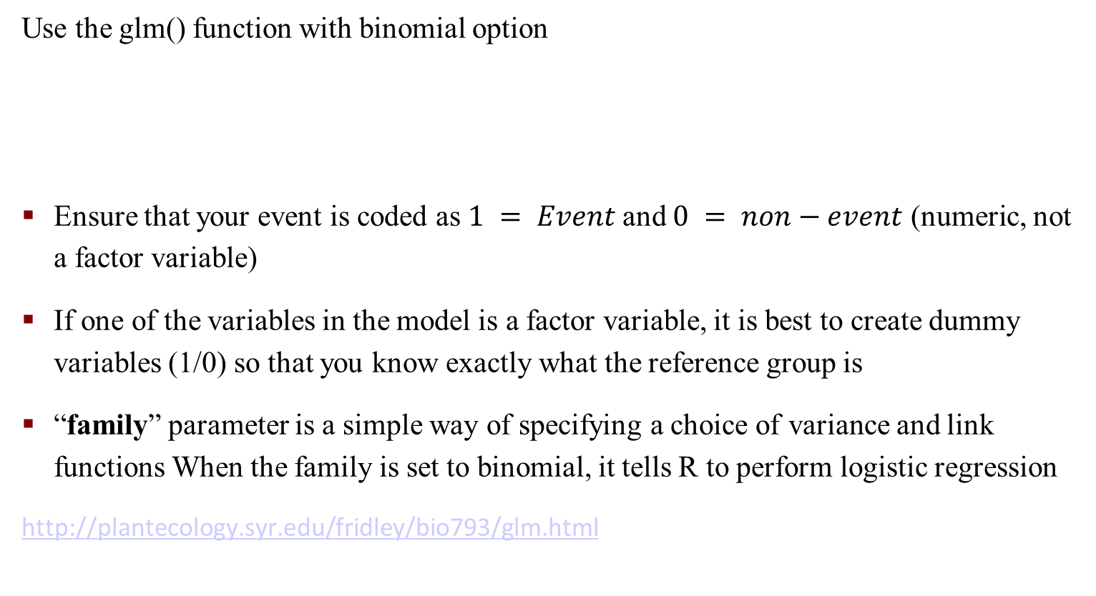
R Commands: Generalized Linear Models (GLMs)
Use the glm() function with binomial option
Ensure that your event is coded as $1 = Event$and $0 = non−event$ (numeric, not a factor variable)
If one of the variables in the model is a factor variable, it is best to create dummy variables (1/0) so that you know exactly what the reference group is
“family” parameter is a simple way of specifying a choice of variance and link functions When the family is set to binomial, it tells R to perform logistic regression
http://plantecology.syr.edu/fridley/bio793/glm.html

Slide 22
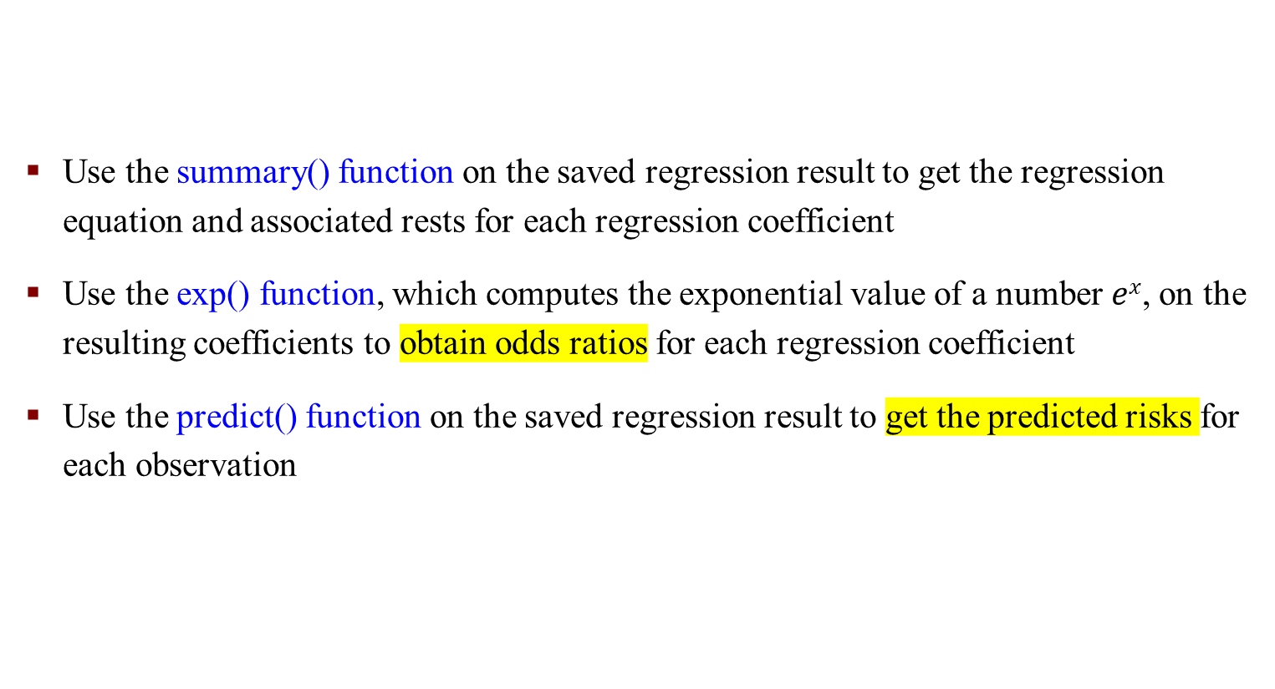
R Commands: Generalized Linear Models (GLMs)
Use the summary() function on the saved regression result to get the regression equation and associated rests for each regression coefficient
Use the exp() function, which computes the exponential value of a number $ex$, on the resulting coefficients to obtain odds ratios for each regression coefficient
Use the predict() function on the saved regression result to get the predicted risks for each observation

Slide 23
Formal Inference in Logistic Regression

Slide 24
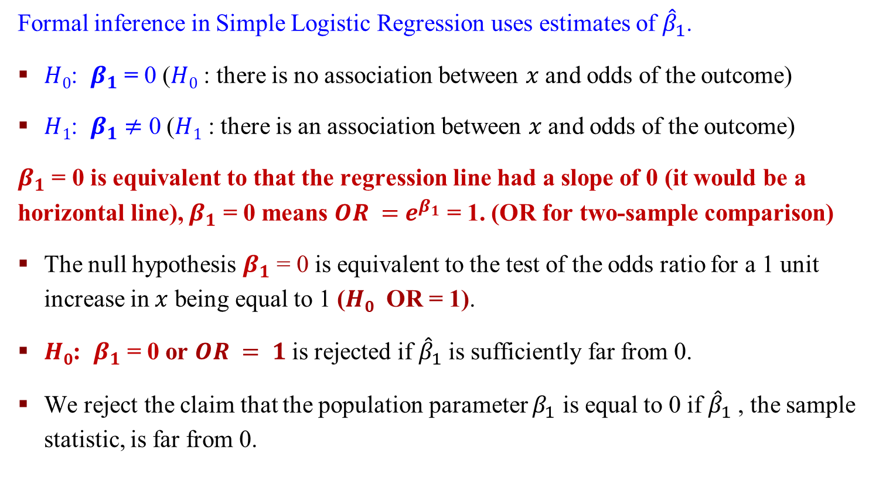
Formal Inference in Simple Logistic Regression
Formal inference in Simple Logistic Regression uses estimates of ${\hat{β}}_{1}$.
$H0$: $β_{1}$ = 0 ($H0$ : there is no association between $x$ and odds of the outcome)
$H1$: $β_{1}$ $≠$ 0 ($H1$ : there is an association between $x$ and odds of the outcome)
$β_{1}$ = 0 is equivalent to that the regression line had a slope of 0 (it would be a horizontal line), $β_{1}$ = 0 means $OR =$ $e^{β_{1}}$ = 1. (OR for two-sample comparison)
The null hypothesis $β_{1}$ = 0 is equivalent to the test of the odds ratio for a 1 unit increase in $x$ being equal to 1 ($H0$ OR = 1).
$H0$: $β_{1}$ = 0 or $OR = 1$is rejected if ${\hat{β}}_{1}$ is sufficiently far from 0.
We reject the claim that the population parameter $β_{1}$ is equal to 0 if ${\hat{β}}_{1}$ , the sample statistic, is far from 0.

Slide 25
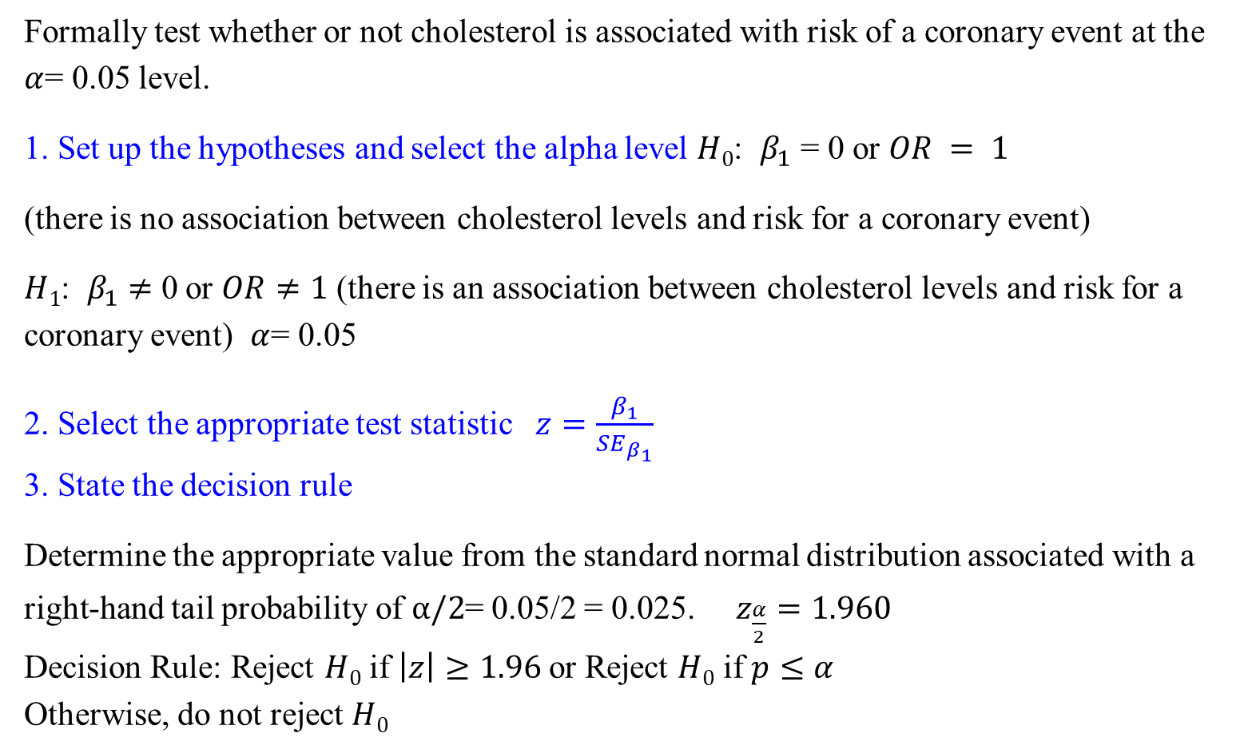
An Example: Logistic Regression Inference
Formally test whether or not cholesterol is associated with risk of a coronary event at the $α$= 0.05 level.
1. Set up the hypotheses and select the alpha level $H0$: $β_{1}$ = 0 or $OR = 1$
(there is no association between cholesterol levels and risk for a coronary event)
$H1$: $β_{1}$ $≠$ 0 or $OR≠1$ (there is an association between cholesterol levels and risk for a coronary event) $α$= 0.05
2. Select the appropriate test statistic $z=\frac{β_{1}}{{SE}_{β_{1}}}$
3. State the decision rule
Determine the appropriate value from the standard normal distribution associated with a right-hand tail probability of $α/2$= 0.05/2 = 0.025. $z_{\frac{α}{2}}=1.960$
Decision Rule: Reject $H0$ if $\left|z\right|≥1.96$or Reject $H0$ if $p≤α$
Otherwise, do not reject $H0$

Slide 26
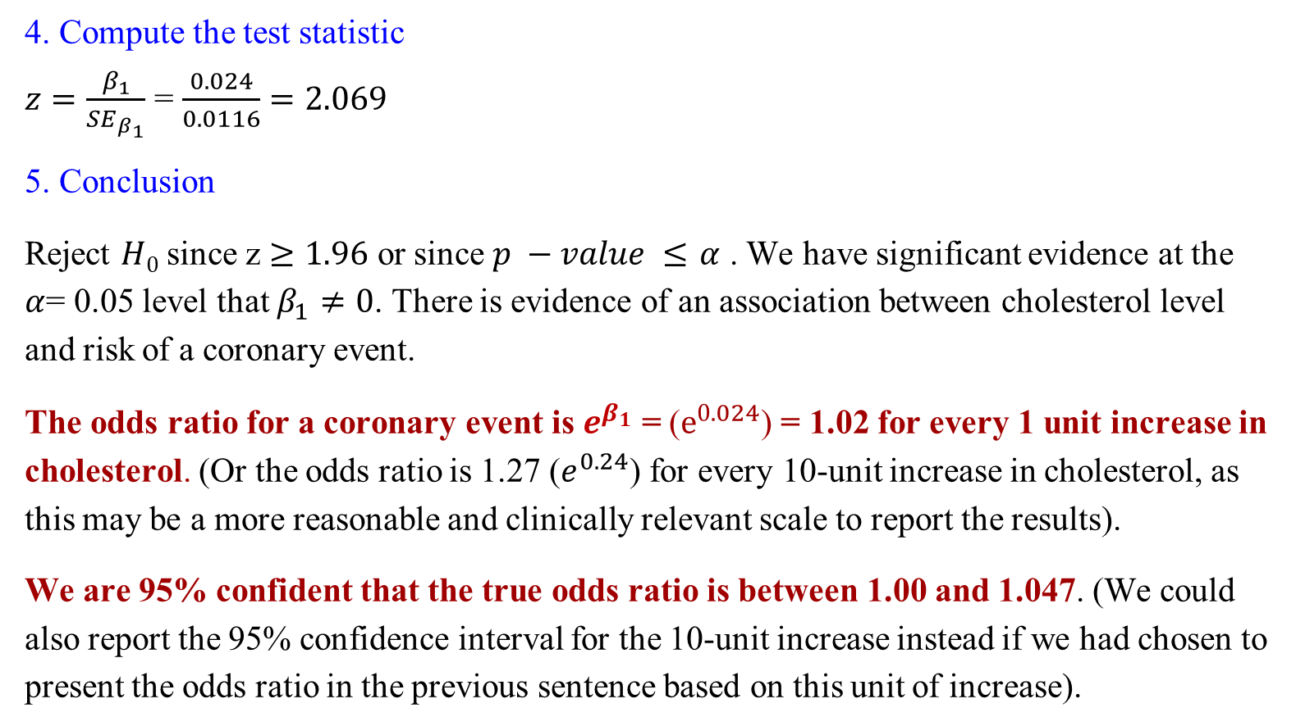
An Example: Logistic Regression Inference
4. Compute the test statistic
$z=\frac{β_{1}}{{SE}_{β_{1}}}$ = $\frac{0.024}{0.0116}=2.069$
5. Conclusion
Reject $H0$ since z $≥1.96$ or since $p −value ≤$ $α$ . We have significant evidence at the $α$= 0.05 level that $β_{1}≠0$. There is evidence of an association between cholesterol level and risk of a coronary event.
The odds ratio for a coronary event is $e^{β_{1}}$ = ($e^{0.024}$) = 1.02 for every 1 unit increase in cholesterol. (Or the odds ratio is 1.27 ($e^{0.24}$) for every 10-unit increase in cholesterol, as this may be a more reasonable and clinically relevant scale to report the results).
We are 95% confident that the true odds ratio is between 1.00 and 1.047. (We could also report the 95% confidence interval for the 10-unit increase instead if we had chosen to present the odds ratio in the previous sentence based on this unit of increase).

Slide 27
R Commands: Predict Method for GLM Fits
The parameter "type" indicates the type of prediction required.
The default is on the scale of the linear predictors; the alternative "response" is on the scale of the response variable. Thus for a default binomial model the default predictions are of log-odds (probabilities on logit scale) and type = “response” gives the predicted probabilities.

Slide 28
R Commands: Predict Method for GLM Fits
Notes:
risk[41], in the data, the patient #41 has 190 cholesterol

Slide 29
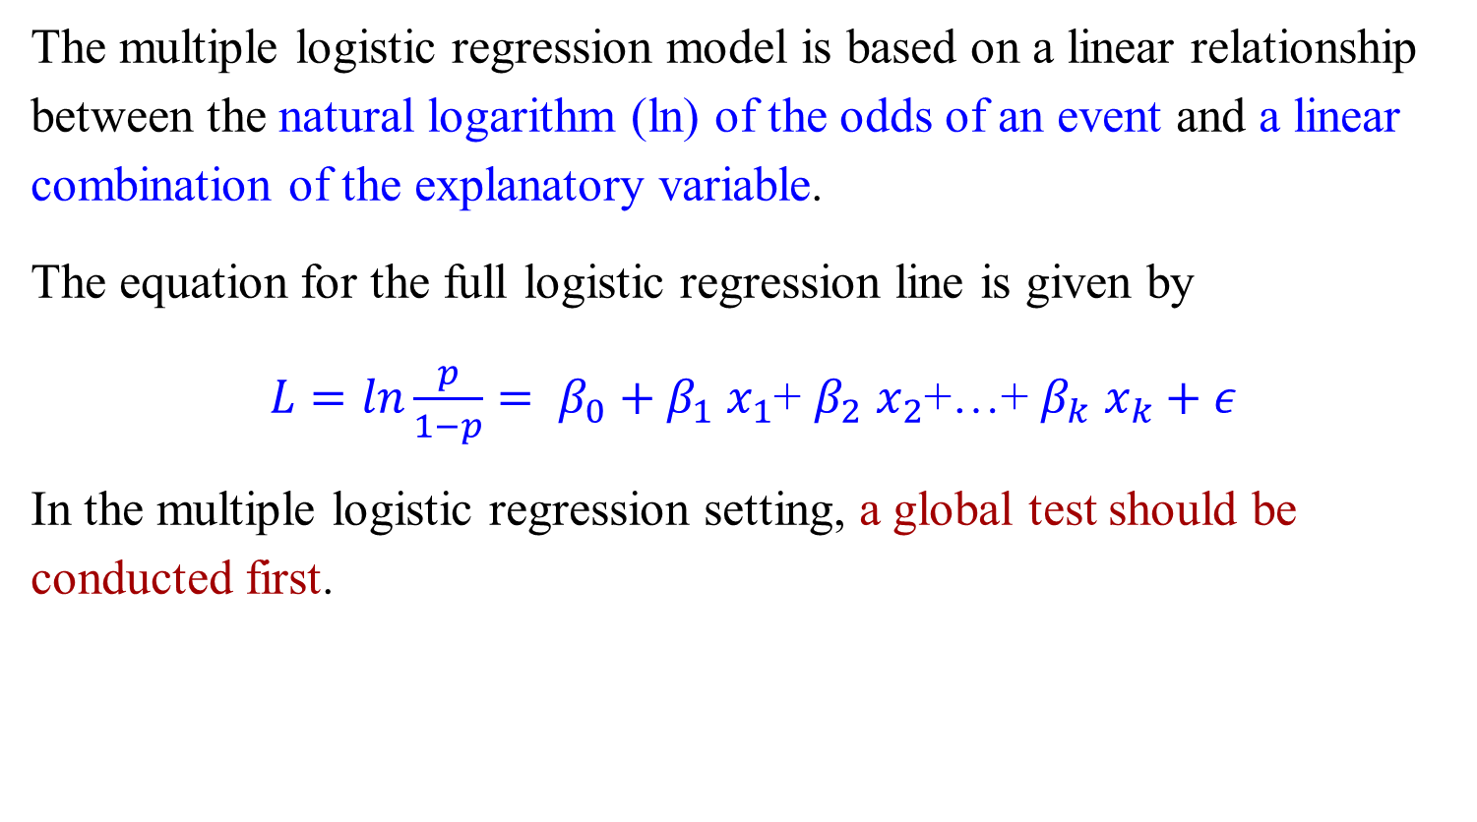
Multiple Logistic Regression
The multiple logistic regression model is based on a linear relationship between the natural logarithm (ln) of the odds of an event and a linear combination of the explanatory variable.
The equation for the full logistic regression line is given by
$L=ln\frac{p}{1−p}= β_{0}+β_{1}$ $x_{1}$+ $β_{2}$ $x_{2}$+…+ $β_{k}$ $x_{k}+ε$
In the multiple logistic regression setting, a global test should be conducted first.

Slide 30

An Example: Multiple Logistic Regression
Our explanatory variables are cholesterol level, age, and gender, and our outcome is whether or not the subject had another coronary event
The p-value for the global test was 0.0058.
A summary of the beta estimates from the model are shown below. Test the global null hypothesis at the $α$= 0.05 level.

Slide 31
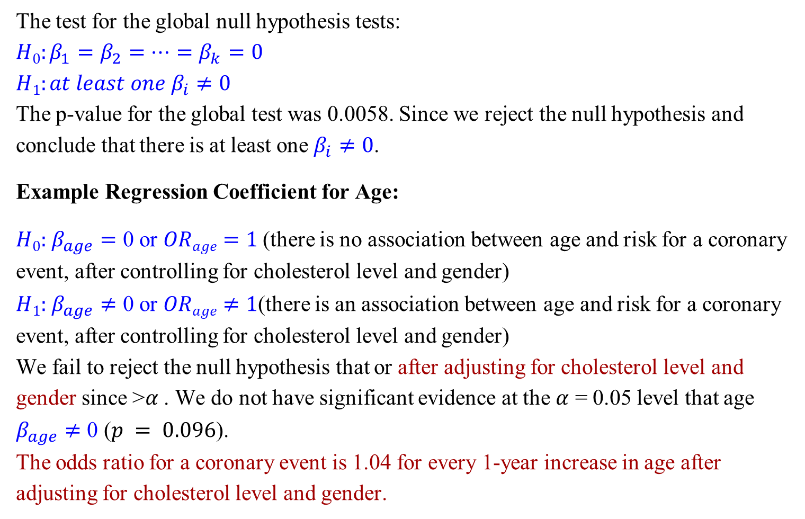
An Example: Multiple Logistic Regression
The test for the global null hypothesis tests:
$$H0:β_{1}=β_{2}=…=β_{k}=0$$
$$H1:at least one β_{i}≠0$$
The p-value for the global test was 0.0058. Since we reject the null hypothesis and conclude that there is at least one $β_{i}≠0$.
Example Regression Coefficient for Age:
$H0:$ $β_{age}=$ 0 or $ORage=1$(there is no association between age and risk for a coronary event, after controlling for cholesterol level and gender)
$H1:$ $β_{age}≠$ 0 or $ORage≠1$(there is an association between age and risk for a coronary event, after controlling for cholesterol level and gender)
We fail to reject the null hypothesis that or after adjusting for cholesterol level and gender since >$α$ . We do not have significant evidence at the $α$ = 0.05 level that age $β_{age}≠$ 0 ($p = 0.096$).
The odds ratio for a coronary event is 1.04 for every 1-year increase in age after adjusting for cholesterol level and gender.

Slide 32
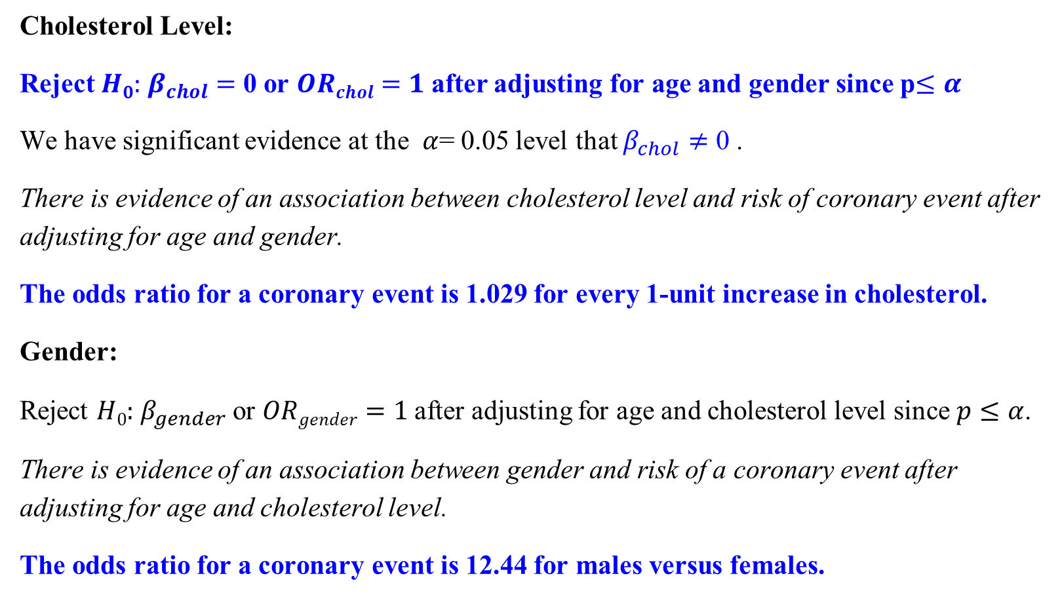
An Example: Multiple Logistic Regression
Cholesterol Level:
Reject $H0:$ $β_{chol}=$ 0 or $ORchol=1$after adjusting for age and gender since p$≤α$
We have significant evidence at the $α$= 0.05 level that $β_{chol}≠$ 0 .
There is evidence of an association between cholesterol level and risk of coronary event after adjusting for age and gender.
The odds ratio for a coronary event is 1.029 for every 1-unit increase in cholesterol.
Gender:
Reject $H0:$ $β_{gender}$or $ORgender=1$after adjusting for age and cholesterol level since $p≤α$.
There is evidence of an association between gender and risk of a coronary event after adjusting for age and cholesterol level.
The odds ratio for a coronary event is 12.44 for males versus females.

Slide 33
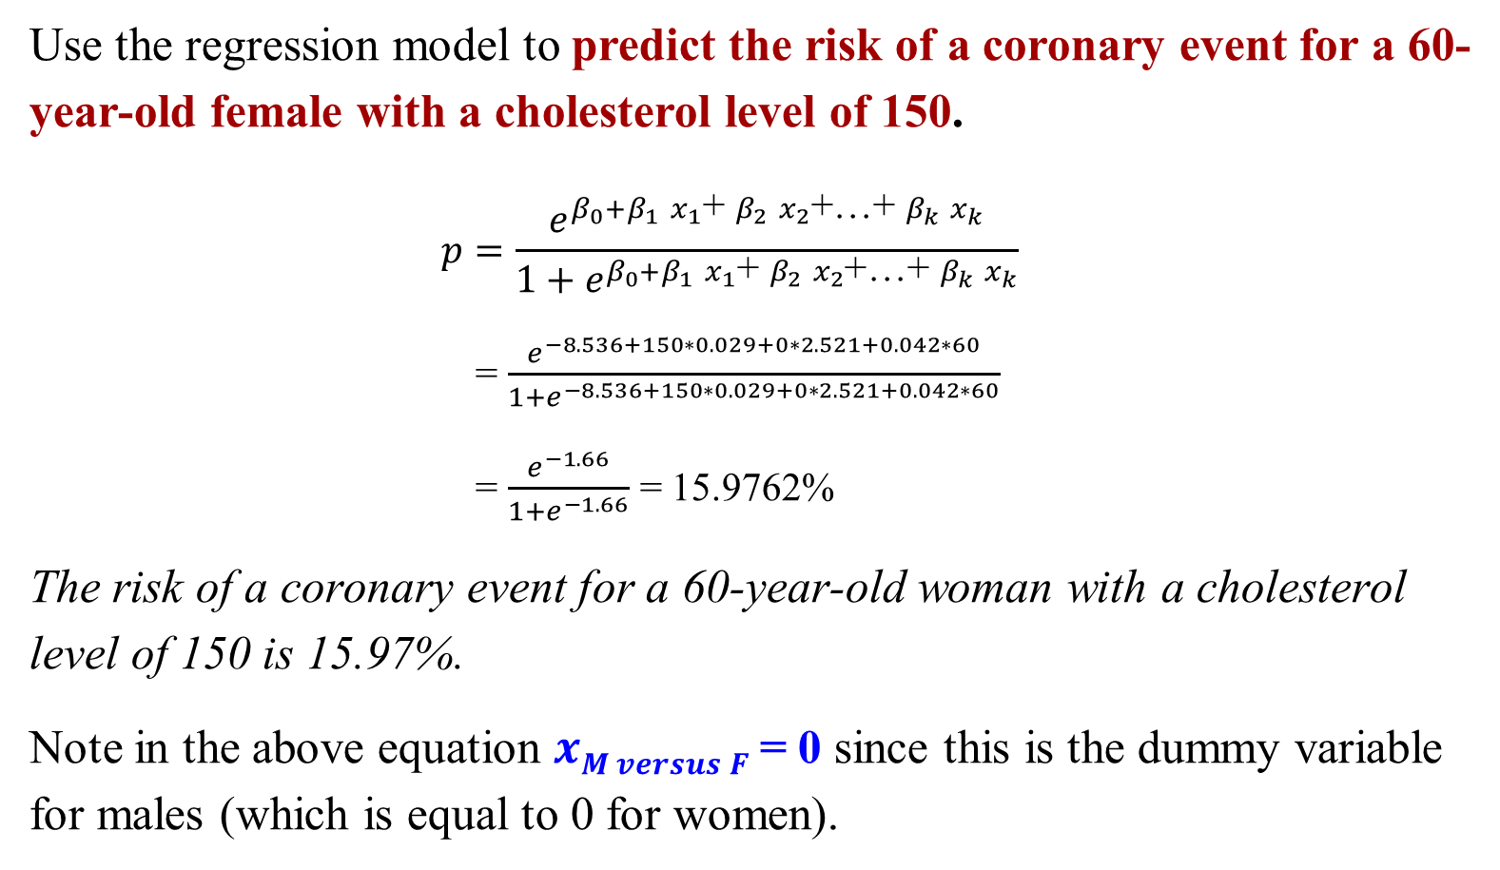
An Example: Multiple Logistic Regression
Use the regression model to predict the risk of a coronary event for a 60-year-old female with a cholesterol level of 150.
$$p=\frac{e^{β_{0}+β_{1} x_{1}\text{+ }β_{2} x_{2}\text{+…+ }β_{k} x_{k}}}{1+e^{β_{0}+β_{1} x_{1}\text{+ }β_{2} x_{2}\text{+…+ }β_{k} x_{k}}}$$
= $\frac{e^{−8.536+150∗0.029+0∗2.521+0.042∗60}}{1+e^{−8.536+150∗0.029+0∗2.521+0.042∗60}}$
= $\frac{e^{−1.66}}{1+e^{−1.66}}$ = 15.9762%
The risk of a coronary event for a 60-year-old woman with a cholesterol level of 150 is 15.97%.
Note in the above equation $xM versus F$= 0 since this is the dummy variable for males (which is equal to 0 for women).

Slide 34
R Commands: Generalized Linear Models (GLMs)
In multiple logistic regression, use the wald.test() function (from aod package) to get p-value for the global test (of all beta coefficients = 0)

Slide 35
Multiple Logistic Regression

Slide 36
Model Fitness in Logistic Regression

Slide 37
Predictions of Logistic Regression
In the logistic regression setting, the observed response takes on one of two values (0 = no event and 1= event).
The predicted probabilities take on values between 0 and 1.
If the predicted probabilities for someone who had the event are close to or equal to 1, then we would say that the model successfully predicted that individual's risk.

Slide 38
How to Quantify the Fitness in Logistic Regression
For example, let's say that all predicted probabilities are 0.32 or 0.72.
What would we say about the fit of the model if all the events had a predicted probability of 0.72 and all the non-events had a predicted probability of 0.32?
We'd like to be inclined to think that the model successfully discriminates between those with and without the event.
What if most of those with a predicted probability of 0.32 did not have the event and most of those with a predicted probability of 0.72 did?
We'd still be inclined to say that the model fit was good.
How we define “most” may vary, and it becomes a little more difficult to assess without having a measure to quantify the fit.

Slide 39
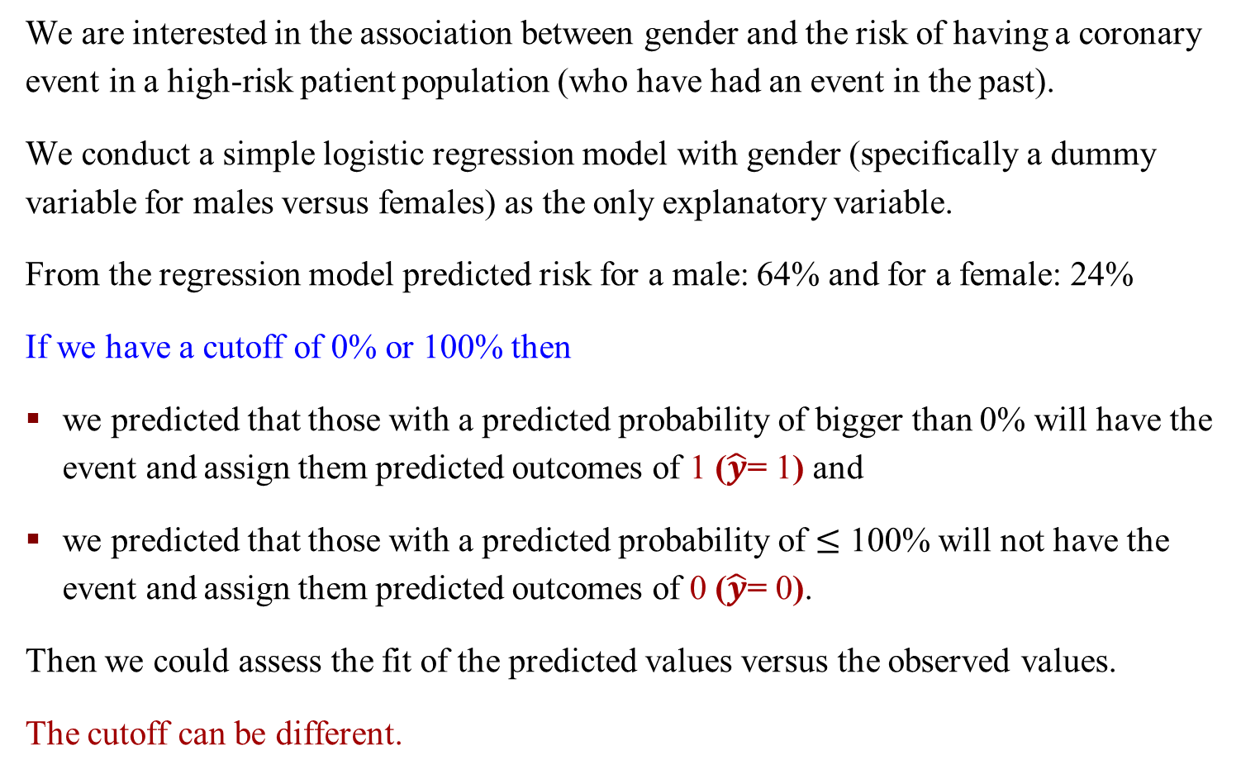
Cutoffs Problem – An Example
We are interested in the association between gender and the risk of having a coronary event in a high-risk patient population (who have had an event in the past).
We conduct a simple logistic regression model with gender (specifically a dummy variable for males versus females) as the only explanatory variable.
From the regression model predicted risk for a male: 64% and for a female: 24%
If we have a cutoff of 0% or 100% then
we predicted that those with a predicted probability of bigger than 0% will have the event and assign them predicted outcomes of 1 ($\hat{y}$= 1) and
we predicted that those with a predicted probability of $≤$ 100% will not have the event and assign them predicted outcomes of 0 ($\hat{y}$= 0).
Then we could assess the fit of the predicted values versus the observed values.
The cutoff can be different.

Slide 40
True/False Positive and True/False Negative
True positive. Rate of Correct identification of Positive category
Example: Sick people correctly identified as sick
False positive. Rate of Incorrect identification of Positive category
Example: Healthy people incorrectly identified as sick
True negative. Rate of Correct identification of Negative category
Example: Healthy people correctly identified as healthy
False negative. Rate of Incorrect identification of Negative category
Example: Sick people incorrectly identified as healthy
In general, Positive = identified and negative = rejected.
Therefore:
True positive = correctly identified
False positive = incorrectly identified
True negative = correctly rejected
False negative = incorrectly rejected

Slide 41
Example
We have identified 30 sick people correctly identified as sick
We have identified 4 healthy people incorrectly identified as sick
We have identified 25 healthy people correctly identified as healthy
We have identified 3 sick people incorrectly identified as healthy
True Positive: 30
False Positive: 4
True Negative: 25
False Negative: 3

Slide 42
Example – Confusion Matrix
We have identified 30 sick people correctly identified as sick
We have identified 4 healthy people incorrectly identified as sick
We have identified 25 healthy people correctly identified as healthy
We have identified 3 sick people incorrectly identified as healthy
True Positive: 30
False Positive: 4
True Negative: 25
False Negative: 3

Slide 43
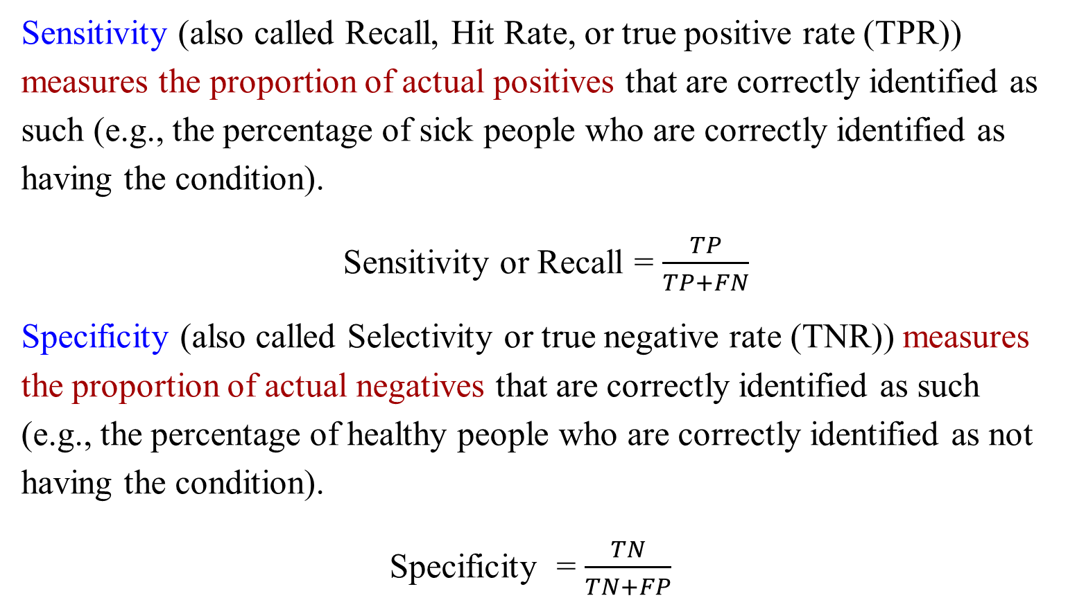
Sensitivity & Specificity
Sensitivity (also called Recall, Hit Rate, or true positive rate (TPR)) measures the proportion of actual positives that are correctly identified as such (e.g., the percentage of sick people who are correctly identified as having the condition).
Sensitivity or Recall = $\frac{TP}{TP+FN}$
Specificity (also called Selectivity or true negative rate (TNR)) measures the proportion of actual negatives that are correctly identified as such (e.g., the percentage of healthy people who are correctly identified as not having the condition).
Specificity = $\frac{TN}{TN+FP}$

Slide 44

Precision
Precision (also called positive predictive value) is the fraction of relevant instances among the retrieved instances.
Precision= $\frac{TP}{TP+FP}$

Slide 45
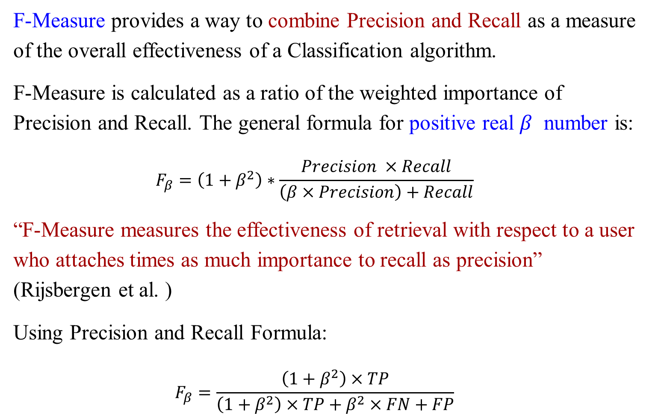
F-Measure & F1 Measure
F-Measure provides a way to combine Precision and Recall as a measure of the overall effectiveness of a Classification algorithm.
F-Measure is calculated as a ratio of the weighted importance of Precision and Recall. The general formula for positive real $β$ number is:
$$F_{β}=\left(1+β^{2}\right)∗\frac{Precision ×Recall}{\left(β×Precision\right)+Recall}$$
“F-Measure measures the effectiveness of retrieval with respect to a user who attaches times as much importance to recall as precision” (Rijsbergen et al. )
Using Precision and Recall Formula:
$$F_{β}=\frac{\left(1+β^{2}\right)×TP}{\left(1+β^{2}\right)×TP+β^{2}×FN+FP}$$
Notes:
$β$ =1, 2, 0.5

Slide 46
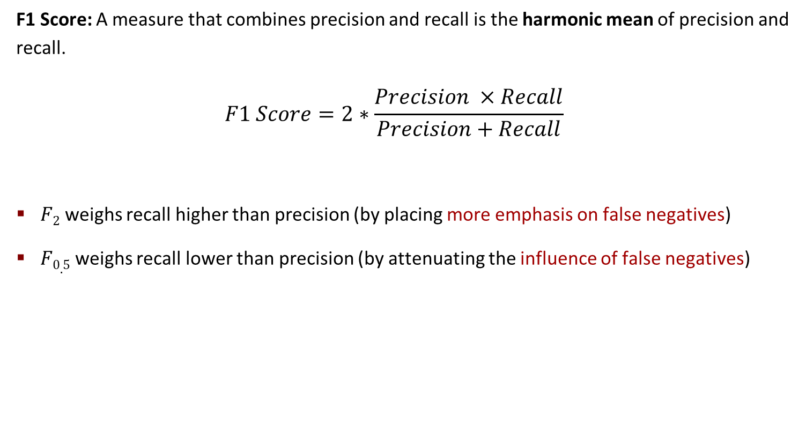
F1 Measure, F2, F0.5
F1 Score: A measure that combines precision and recall is the harmonic mean of precision and recall.
$$F1 Score=2∗\frac{Precision ×Recall}{Precision+Recall}$$
$F2$ weighs recall higher than precision (by placing more emphasis on false negatives)
$F0.5$ weighs recall lower than precision (by attenuating the influence of false negatives)
Notes:
harmonic谐波
attenuating衰减

Slide 47
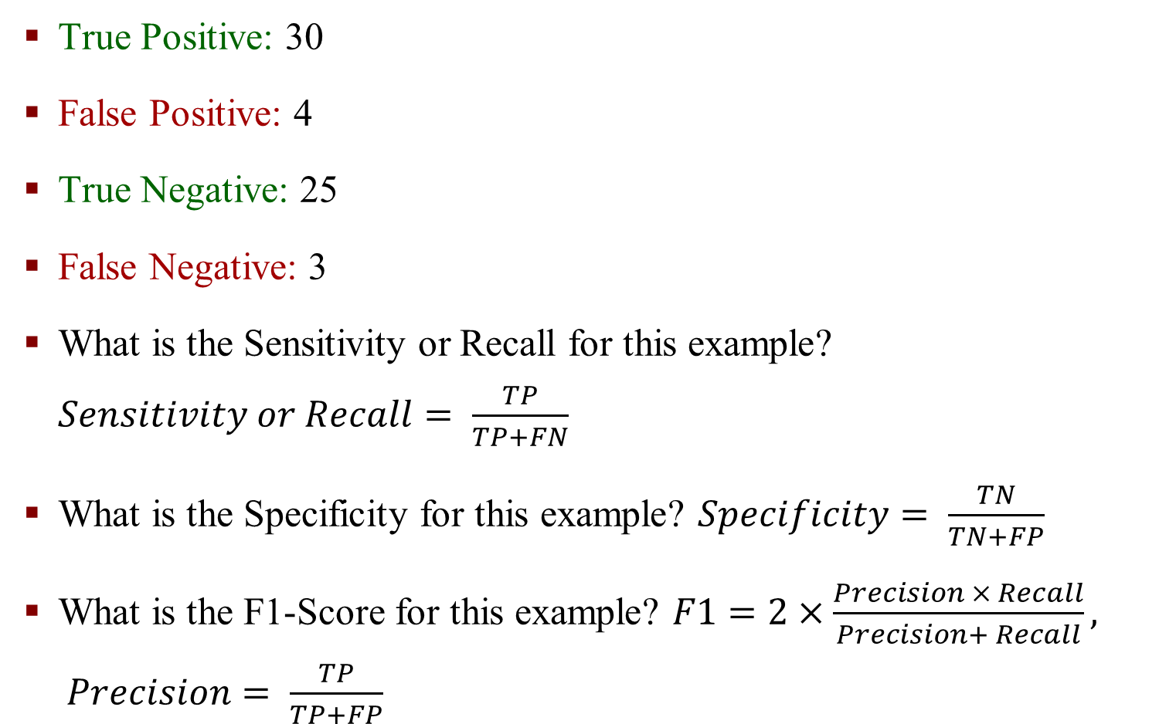
Example
True Positive: 30
False Positive: 4
True Negative: 25
False Negative: 3
What is the Sensitivity or Recall for this example? $Sensitivity or Recall= \frac{TP}{TP+FN}$
What is the Specificity for this example? $Specificity= \frac{TN}{TN+FP}$
What is the F1-Score for this example? $F1=2×\frac{Precision × Recall}{Precision+ Recall}, Precision= \frac{TP}{TP+FP}$

Slide 48
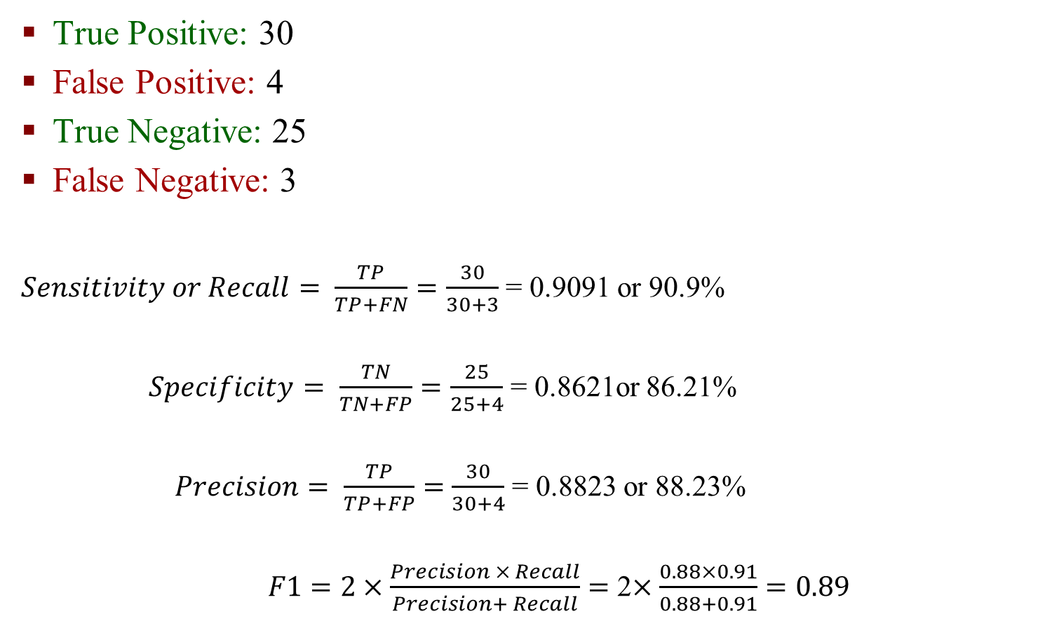
Example
True Positive: 30
False Positive: 4
True Negative: 25
False Negative: 3
$Sensitivity or Recall= \frac{TP}{TP+FN}=\frac{30}{30+3}$ = 0.9091 or 90.9%
$Specificity= \frac{TN}{TN+FP}=\frac{25}{25+4}$ = 0.8621or 86.21%
$Precision= \frac{TP}{TP+FP}=$ $\frac{30}{30+4}$ = 0.8823 or 88.23%
$F1=2×\frac{Precision × Recall}{Precision+ Recall}=$ 2$×\frac{0.88×0.91}{0.88+0.91}=0.89$

Slide 49
Receiver Operating Characteristic Curve (ROC Curve)

Slide 50
ROC (Receiver Operating Characteristic)
Sensitivity and specificity are important measures in assessing the fit of a logistic regression model.
Models with one or more continuous explanatory or independent variables have more possible values for the predicted probabilities. Therefore, many cutoffs often produce distinct values of sensitivity and specificity.
The area under the ROC (receiver operating characteristic) curve (also known as the c-statistic) measures the sensitivity and specificity across the range of all possible cutoffs.
It is used to measure the goodness of fit of a logistic regression model.

Slide 51
ROC (Receiver Operating Characteristic)
The ROC curve is a plot of corresponding pairs of sensitivity (y-axis) and 1 minus the specificity (x-axis) for each possible cutoff point.
It ranges between 0.5 and 1.0 with larger values indicating a better fit.
When the area under the curve is equal to 0.50, it is said that the model does no better at classifying events than at random or by chance.

Slide 52
Area Under the ROC Curve: R Commands

Slide 53
ROC – False Positive Rate, True Positive Rate

Slide 54
Multiple Logistic Regression and Area Under ROC Curve

